Slide 1
Cash application – An overview & Proof of concept demonstration
Notes:
[Filename Convention: Customer Confirmation Session E2E Functional Area YYYYMMDD
YYYYDDMM should equal the date of the workshop
E2E Acronym by Business Process Area
AA2R Asset Acquire to Retire
CR2P Customer Requisition to Payment
GA2C Grant Award to Close
H2R Hire to Retire
MCFA Manage Cash and Financial Assets
PMTB Plan and Manage the Business
P&SC Procurement and Supply Chain
PI2C Project Inception to Close
R2R Record to Report ]

Slide 2
Cash Application - Overview
What is Cash Application in Workday:
Cash Application is the process of recording the receipt of a customer/sponsor payment and applying the received payments to our open customer and sponsor invoices.
UW Change Impact Updates:
Current State: Units manage their own cash application to invoices in a disparate manner (exceptions such as GCA or SFS)
Future State: Cash Application is slated to occur at a more centralized Org-Wide level to promote the University’s transformation goals (referred to as Cash Application Centers)
Decision from October 2020, confirmed again in January 2022
Notes:
Cash Payment Type applied to invoices – Burke Museum Membership, Dentistry Clinics
Olivia -

Slide 3
Cash Application – High level process
3 Steps make up Cash Application in Workday:
Customer Payment
Customer Deposit
Customer Payment Application
Perform Cash Application
Record Customer Payment
Create Customer Deposit
Customer Invoice Cash Application
Bank Reconciliation
Notes:
Cash Payment Type applied to invoices – Burke Museum Membership, Dentistry Clinics
Olivia -

Slide 4
Cash Application - Overview
What goes into the Cash Application process:
Step/Process | Accounting | Notes
(Pre-Req) Create Customer/Sponsored Invoice | DR: Accounts Receivable CR: Revenue | Invoice is external document sent to our customers requesting payment
Record Customer / Sponsor Payment | DR: N/A CR: N/A | Recorded at Customer Level Produces no accounting
Create a Deposit | DR: Cash CR: Unapplied Recorded Payments | Must be recorded AFTER the payment Cash Ledger requires a bank account worktag
Application of Payment | DR: Unapplied Recorded Payments CR: Accounts Receivable | Application is performed at an invoice or customer account level Auto-Apply or manual application in WD
Notes:
Cash Payment Type applied to invoices – Burke Museum Membership, Dentistry Clinics
Olivia -

Slide 5
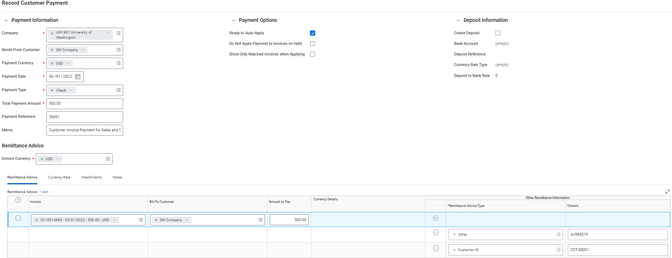
Cash Application – Record Customer Payment
1. Recording of the Customer/Sponsor Payment (No Accounting)
Notes:
Cash Payment Type applied to invoices – Burke Museum Membership, Dentistry Clinics
Olivia -

Slide 6
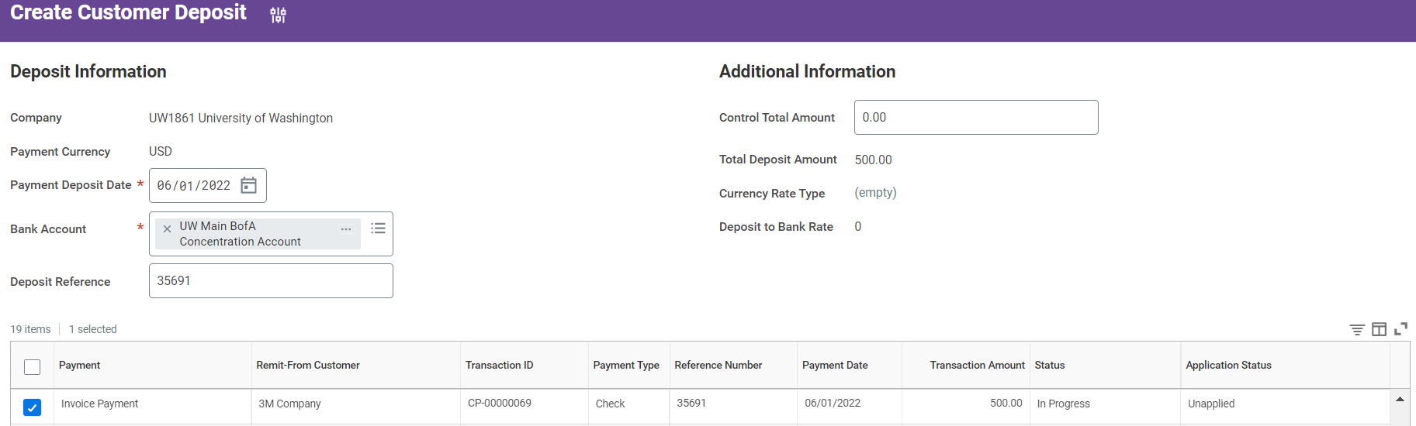
Cash Application – Create customer deposit
Depositing of the Customer/Sponsor Payment
(DR: Cash, CR: Unapplied Recorded Payment)
Notes:
Cash Payment Type applied to invoices – Burke Museum Membership, Dentistry Clinics
Olivia -

Slide 7
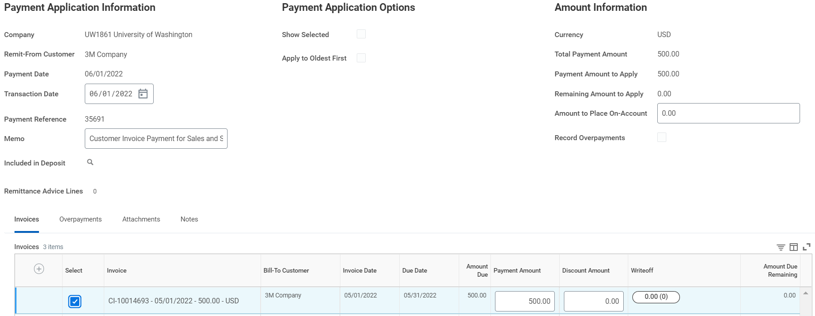
Cash Application – apply customer payment
3. Application of the Customer/Sponsor Payment to an open invoice or customer account (DR: Unapplied Recorded Payment, CR: AR)
Notes:
Cash Payment Type applied to invoices – Burke Museum Membership, Dentistry Clinics
Olivia -

Slide 8
Cash application environment – Electronic payments
Notes:
Cash Payment Type applied to invoices – Burke Museum Membership, Dentistry Clinics
Olivia -

Slide 9
Cash App Automation: Invoiced (w/ remittance)

Slide 10
Cash app environment – Electronic payments
Customer Payment/Deposit Integration from EDI 822 File from Bank of America
Notes:
Cash Payment Type applied to invoices – Burke Museum Membership, Dentistry Clinics
Olivia -

Slide 11
Cash Application – automation opportunity
Problem Statement:
UW receives a large volume of ACH and Wire Payments to their bank account daily. They’re seeking an expedited way to record, deposit, and apply these payments.
Proposed Solution:
Utilize Workday integrations from the Bank’s Payment Reporting (EDI822) to Record a payment, create the deposit, and provide detailed information for streamlined cash application.
Notes:
Cash Payment Type applied to invoices – Burke Museum Membership, Dentistry Clinics
Olivia -

Slide 12
Cash Application – Proof of concept process
Goal: Automate as much of the cash application process to save time, promote consistency, and limit manual errors
Customer Invoice Created
Customer sends payment to UW
Financial Institution Reports Received
Record Customer Payment (via Integration)
INT001
Source
INT002
Create Customer Deposit (via Integration)
Perform payment auto-application to invoices
Manage Exceptions
END
Notes:
Cash Payment Type applied to invoices – Burke Museum Membership, Dentistry Clinics
Olivia -

Slide 13
Cash Application demo – Automation Proof of concept
Open/Unpaid Customer Invoice created in Workday
Bank Report (EDI822) File Receipt, Formatted for the integration
Record Customer Payment Integration
Show eligibility for creation of customer deposit and cash application
Notes:
Cash Payment Type applied to invoices – Burke Museum Membership, Dentistry Clinics
Olivia -

Slide 14
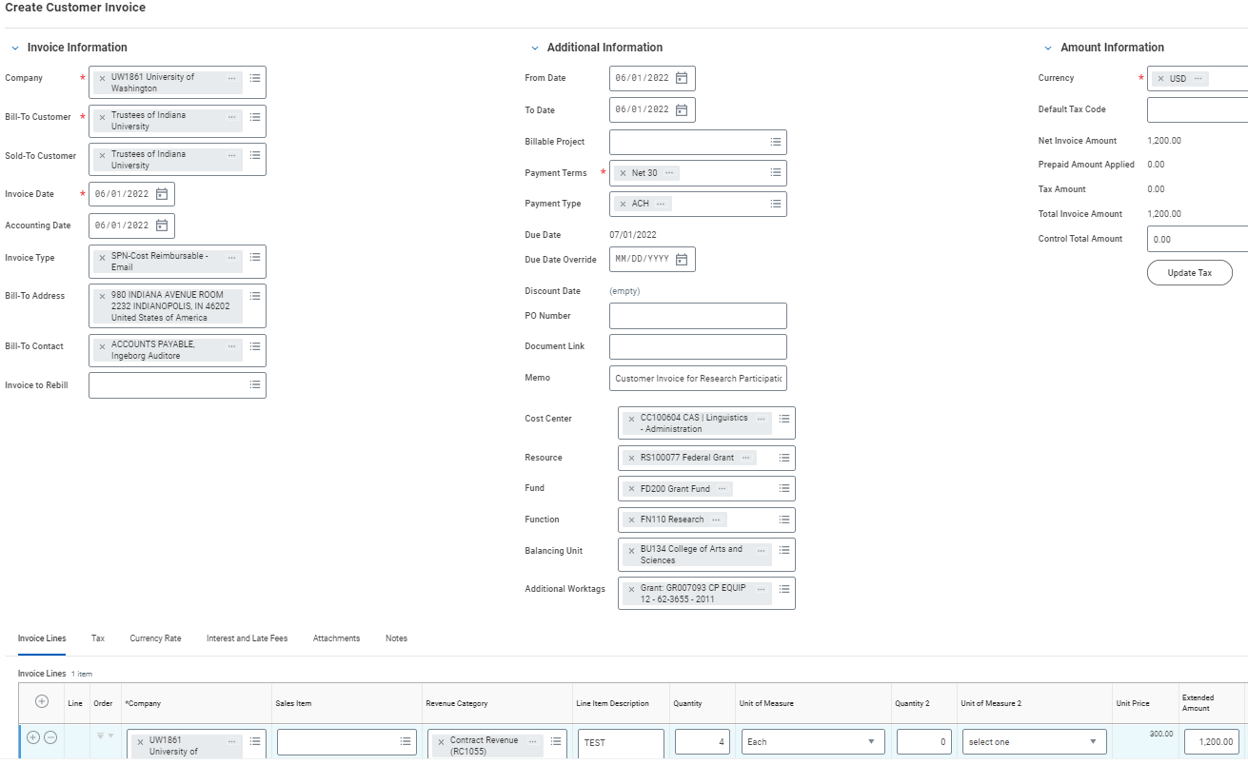
Cash Application demo – Automation Proof of concept
1. Customer Invoice
created in Workday
DR: AR
CR: Revenue
Notes:
Cash Payment Type applied to invoices – Burke Museum Membership, Dentistry Clinics
Olivia -

Slide 15
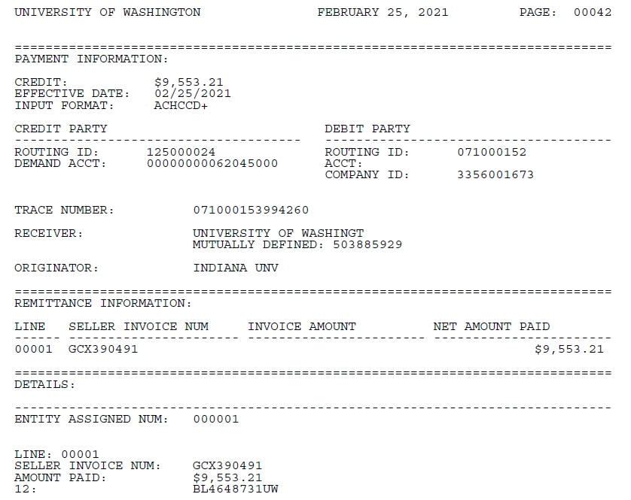
Cash Application demo – Automation Proof of concept
2. EDI822 Report (source) from the bank; with Remittance information
Notes:
Cash Payment Type applied to invoices – Burke Museum Membership, Dentistry Clinics
Olivia -

Slide 16
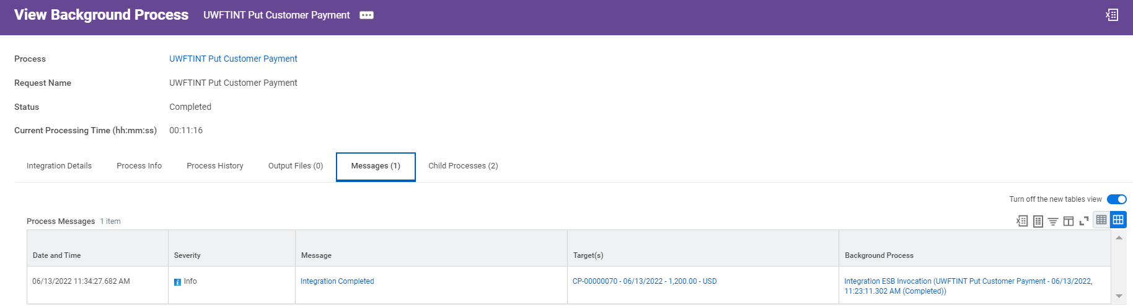
Cash Application demo – Automation Proof of concept
3. Run an integration to record customer payment from the payment file
Notes:
Cash Payment Type applied to invoices – Burke Museum Membership, Dentistry Clinics
Olivia -

Slide 17
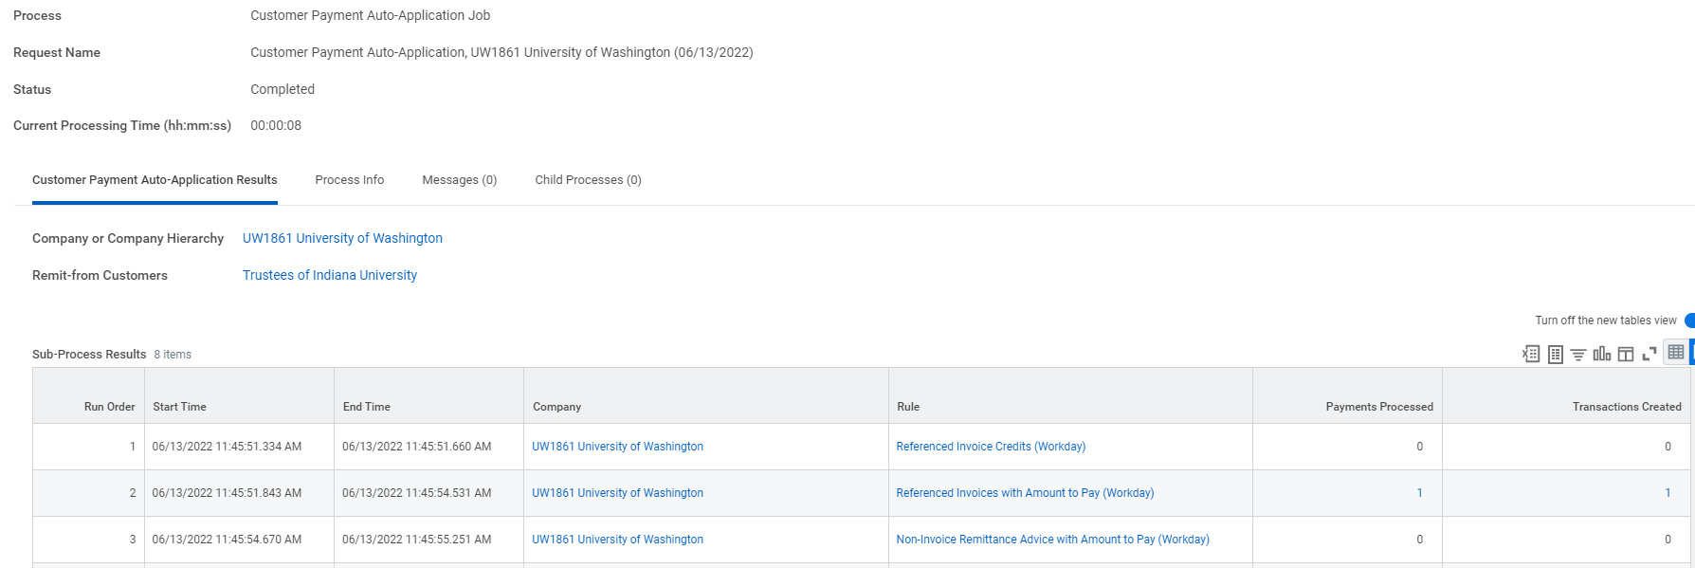
Cash Application demo – Automation Proof of concept
4. Payment is posted and eligible for Auto-Application
Notes:
Cash Payment Type applied to invoices – Burke Museum Membership, Dentistry Clinics
Olivia -

Slide 18
Exception management: Invoiced (No remittance)

Slide 19
Cash app environment – Electronic payments
Customer Payment/Deposit Integration from EDI 822 File from Bank of America
Notes:
Cash Payment Type applied to invoices – Burke Museum Membership, Dentistry Clinics
Olivia -

Slide 20
Invoiced (Non-Remittance)
Problem Statement:
Customers/Sponsors will not always provide enough information to assist in application. UW needs a consistent process to troubleshoot and manage these exceptions
Proposed Solution:
Continue to utilize integrations to post these payments consistently, then make manual corrections to improve application/reporting.
Recommended Steps:
Post Customer Payment consistently with as much detail as available (i.e. – Default company = UW1861, Remit-From Customer = “Blank”, etc.)
Continue to Create Customer Deposit via integration with bank account worktag
Due to behavior above, payment will be ineligible for application. Payment specialist will manually edit the payment to provide customer name and auto- apply
Notes:
Cash Payment Type applied to invoices – Burke Museum Membership, Dentistry Clinics
Olivia -

Slide 21
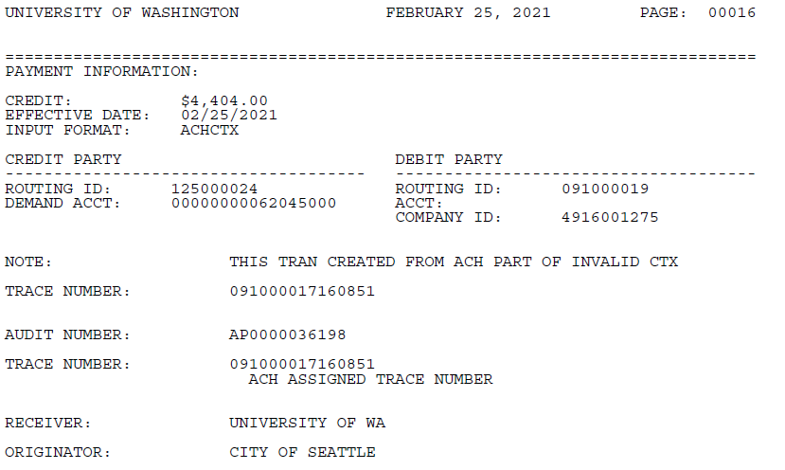
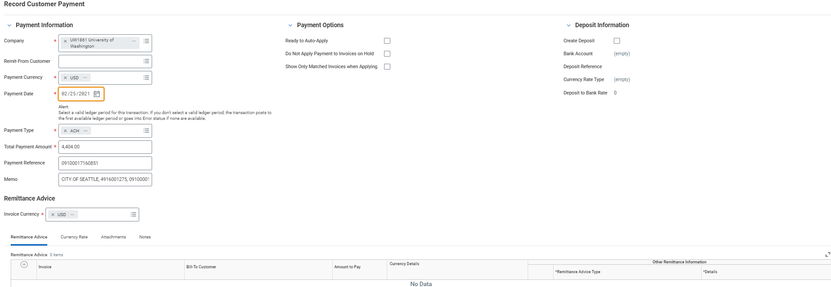
Exception Management (manual)
Notes:
Cash Payment Type applied to invoices – Burke Museum Membership, Dentistry Clinics
Olivia -

Slide 22
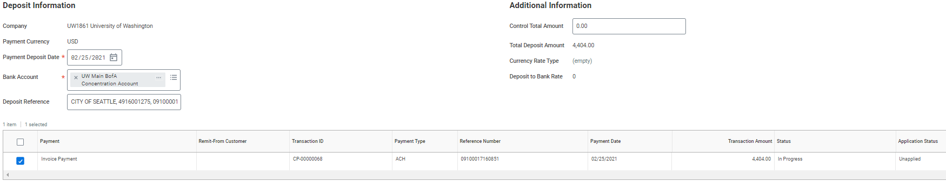
Exception Management (manual)
Notes:
Cash Payment Type applied to invoices – Burke Museum Membership, Dentistry Clinics
Olivia -

Slide 23
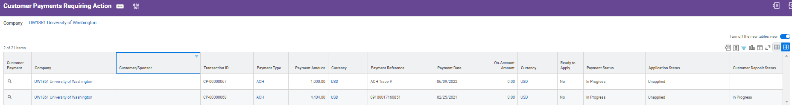
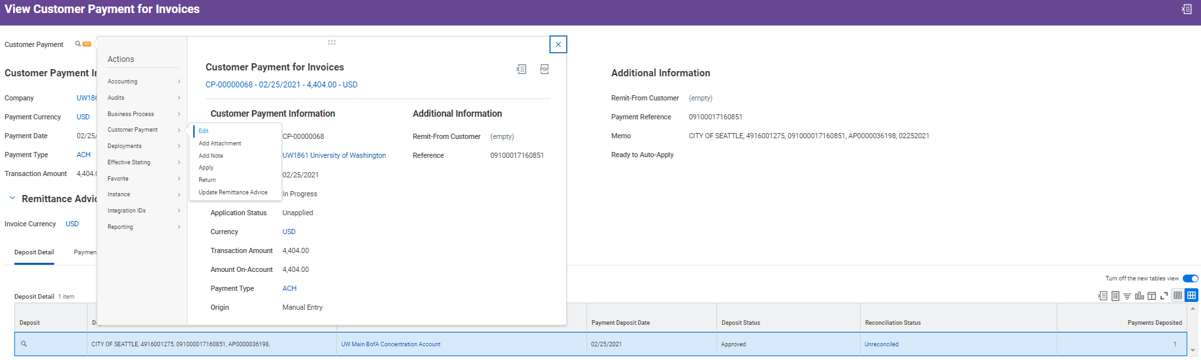
Exception Management (manual)
Notes:
Cash Payment Type applied to invoices – Burke Museum Membership, Dentistry Clinics
Olivia -

Slide 24
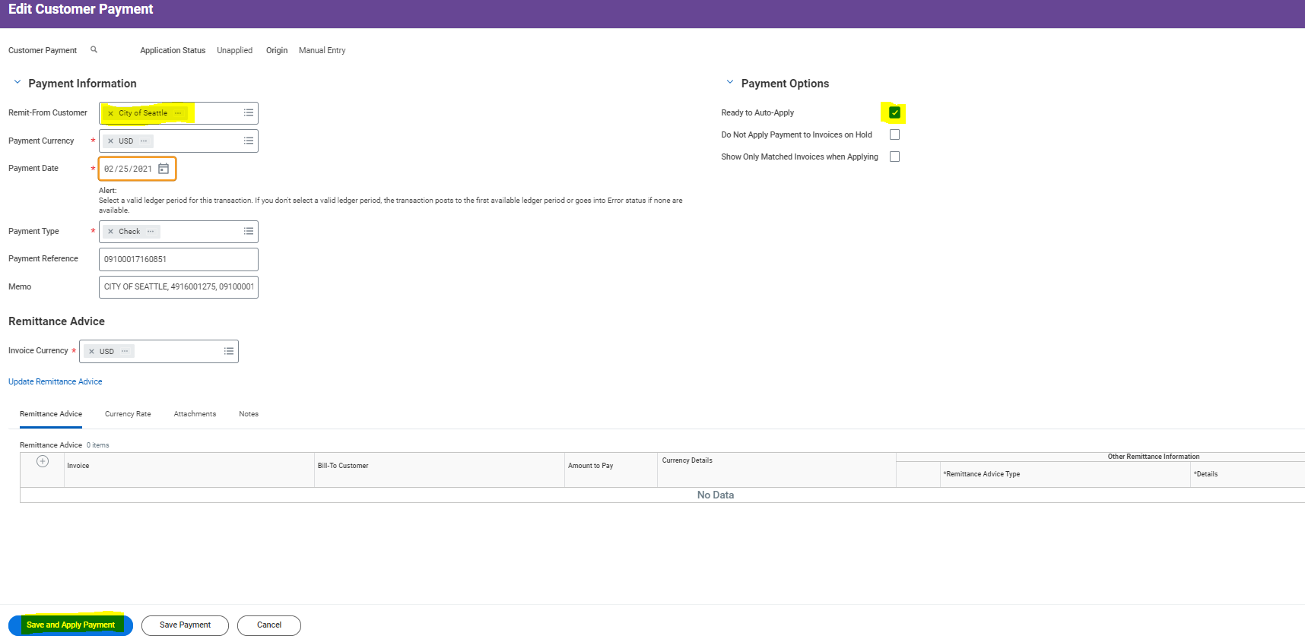
Exception Management (manual)
Notes:
Cash Payment Type applied to invoices – Burke Museum Membership, Dentistry Clinics
Olivia -

Slide 25
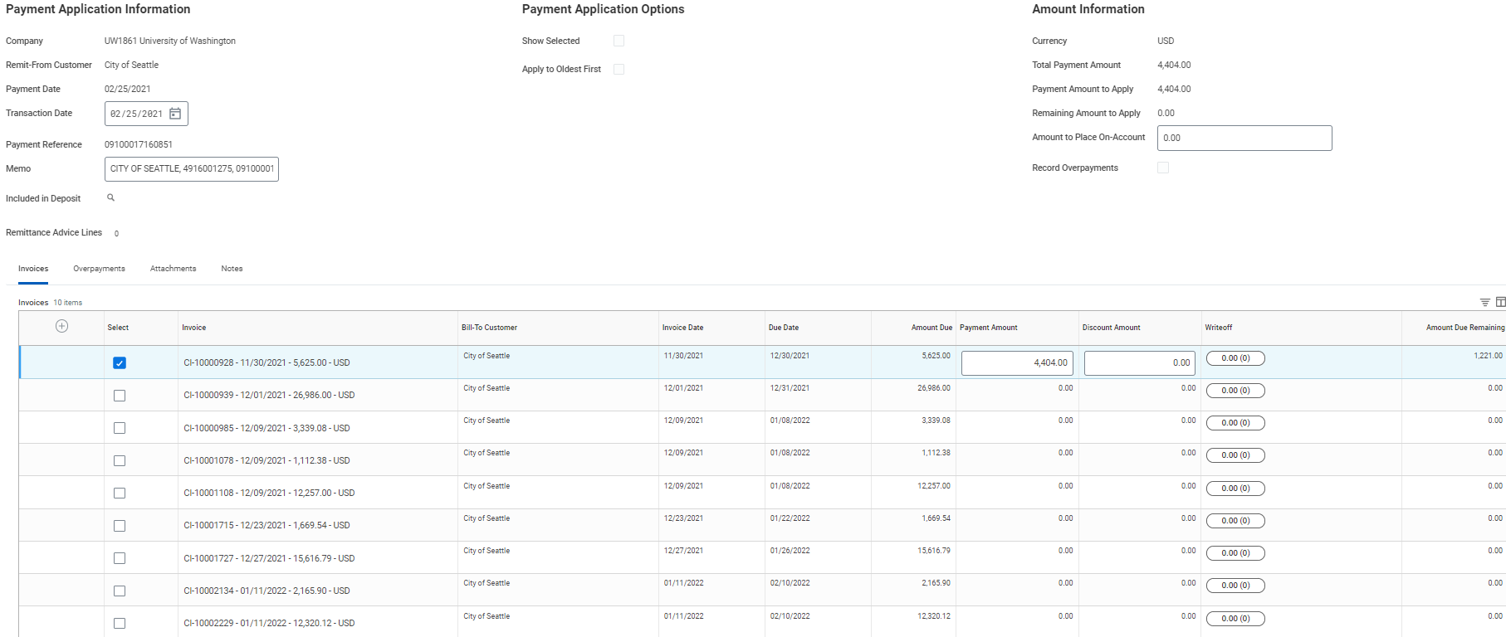
Exception Management (manual)
Notes:
Cash Payment Type applied to invoices – Burke Museum Membership, Dentistry Clinics
Olivia -

Slide 26
Action Items/Next Steps
Kamesh Naidoo and Jessica Green will collaborate to PM and schedule the remaining body of work.
Follow-up Meetings:
Integration Mapping Confirmation Session (Record Customer Payment and Create Customer Deposit)
Action Items:
2 new Integrations to be added to the UWFT Integration Inventory
Integration Mapping Confirmation Session to be scheduled by assigned PMs with associated stakeholders
Bring Transaction volumes and data samples associated with the EDI822 file for both Remittance included and non-included transactions.
Notes:
Cash Payment Type applied to invoices – Burke Museum Membership, Dentistry Clinics
Olivia -

Slide 27
Thank You!
Q&A
Notes:
Cash Payment Type applied to invoices – Burke Museum Membership, Dentistry Clinics
Olivia -

Slide 28
Exception management: non-Invoiced payments

Slide 29
Cash application environment – Electronic payments
Notes:
Cash Payment Type applied to invoices – Burke Museum Membership, Dentistry Clinics
Olivia -

Slide 30
Cash app environment – Electronic payments
Leverage integrations/Customer Overpayment
Notes:
Cash Payment Type applied to invoices – Burke Museum Membership, Dentistry Clinics
Olivia -

Slide 31
Non-Invoiced
Problem Statement:
Customers/Sponsors will not always provide enough information to assist in application and occasionally will provide payments that are non-invoiced Gift or Student related payments. UW needs a consistent and efficient process to manage these scenarios.
Proposed Solution:
Continue to utilize integrations to post these payments consistently, then make manual corrections to maintain automation while placing payments in appropriate buckets.
Recommended Steps:
Post Customer Payment consistently with as much detail as available (i.e. – Default company = UW1861, Remit-From Customer = “Blank”, etc.)
Continue to Create Customer Deposit via integration with bank account worktag
Due to behavior above, payment will be ineligible for application. Payment specialist will manually edit the payment to provide customer name/details and record an overpayment with appropriate accounting entries as specified by the involved unit.
Notes:
Cash Payment Type applied to invoices – Burke Museum Membership, Dentistry Clinics
Olivia -

Slide 32
Non-Invoiced: Process Flow
Goal: Assume payment is a customer payment until confirmation is received to promote automation, once payment is researched, perform a customer overpayment to place the payment in its appropriate area with proper accounting.
1
No customer/sponsor invoice exists for portion of payment, but UW receives ACH EDI822 file
identifying ACH deposit with no remittance advice
2
Use an integration to record a Customer/Sponsor Payment, no remittance advice present so customer
name remains empty and company defaults as UW1861. Use an integration to record a customer deposit
3
After initial research, manually edit the payment to add an appropriate customer name. During
application, apply as much payment as available and place any remaining balance as ‘On-Account’.
4
Once research is complete and payment is determined as Non-Invoiced in Workday, leverage Customer Overpayment functionality and APRs to move funds to appropriate accounting home
5
Notify the involved unit/3rd party system of the payment entry so they can maintain their own
application process (i.e. SDB, Tandem, etc.)
Notes:
Cash Payment Type applied to invoices – Burke Museum Membership, Dentistry Clinics
Olivia -

Slide 33
1. Customer/sponsor payment received
Notes:
Cash Payment Type applied to invoices – Burke Museum Membership, Dentistry Clinics
Olivia -

Slide 34
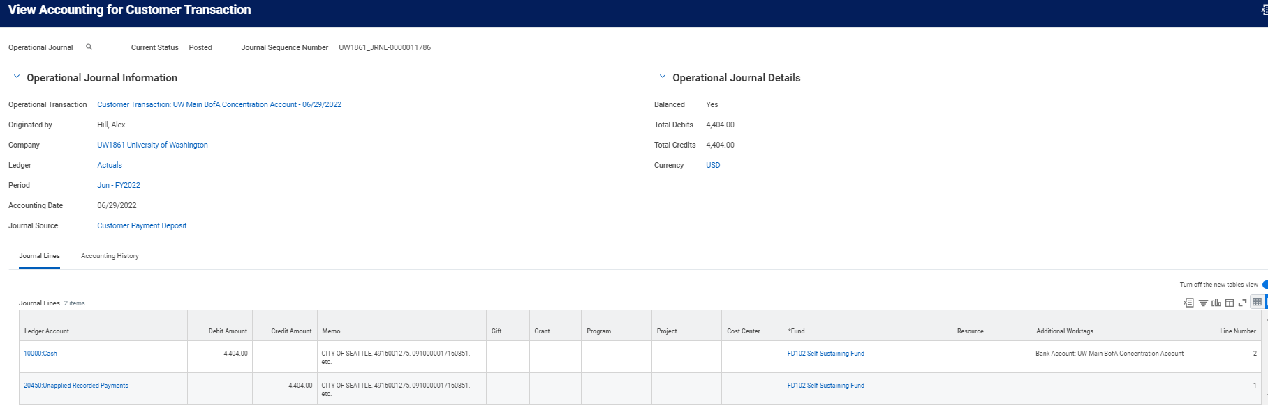
2. Non-invoiced: Payment/Deposit recorded via integration
Cash Application Center should still utilize an integration for customer payment & deposit, in order to recognize cash in a timely manner regardless of payments unidentified home.
Notes:
Cash Payment Type applied to invoices – Burke Museum Membership, Dentistry Clinics
Olivia -

Slide 35
3. Non-Invoiced: Manually Edit/update payment
Notes:
Cash Payment Type applied to invoices – Burke Museum Membership, Dentistry Clinics
Olivia -

Slide 36
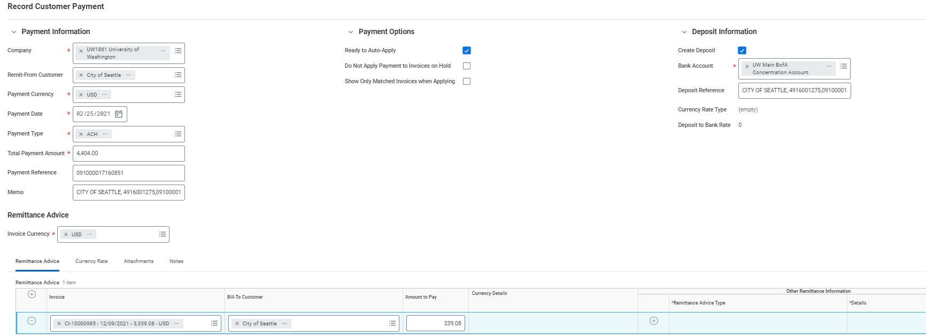
3. Non-invoiced: manually edit/update payment
3
Notes:
Cash Payment Type applied to invoices – Burke Museum Membership, Dentistry Clinics
Olivia -

Slide 37
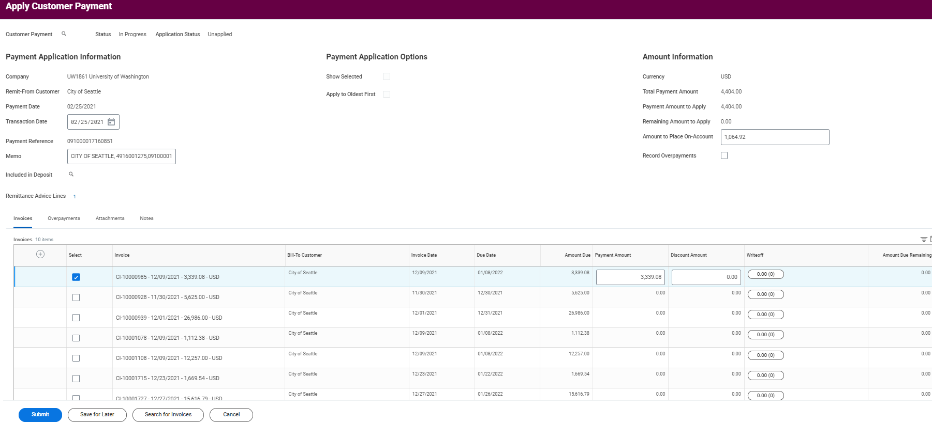
3. Non-invoiced: Apply to On-Account
Notes:
Cash Payment Type applied to invoices – Burke Museum Membership, Dentistry Clinics
Olivia -

Slide 38
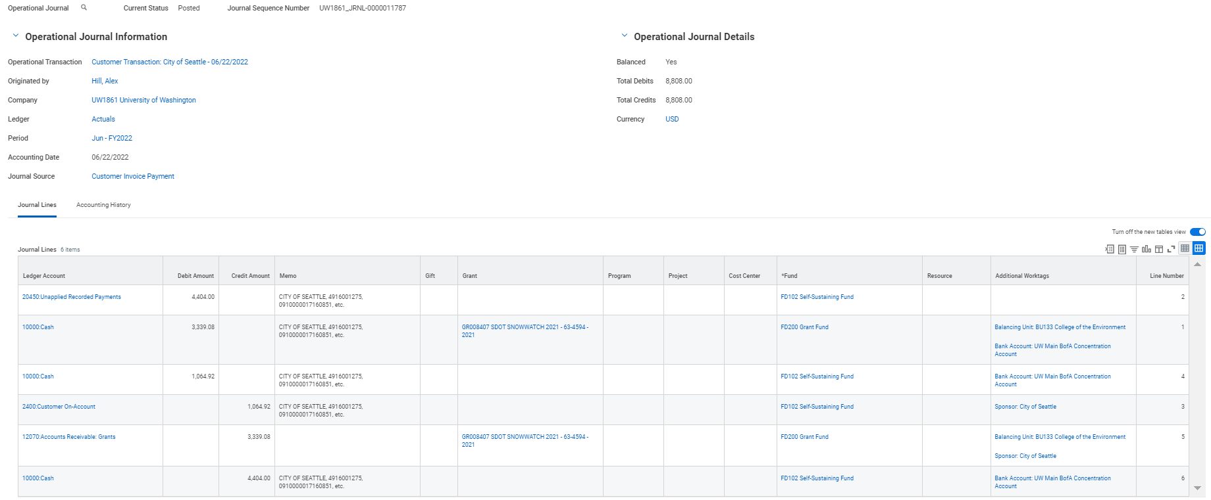
3. Non-invoiced: Apply to On-Account (Accounting)
Cash
Notes:
Cash Payment Type applied to invoices – Burke Museum Membership, Dentistry Clinics
Olivia -

Slide 39
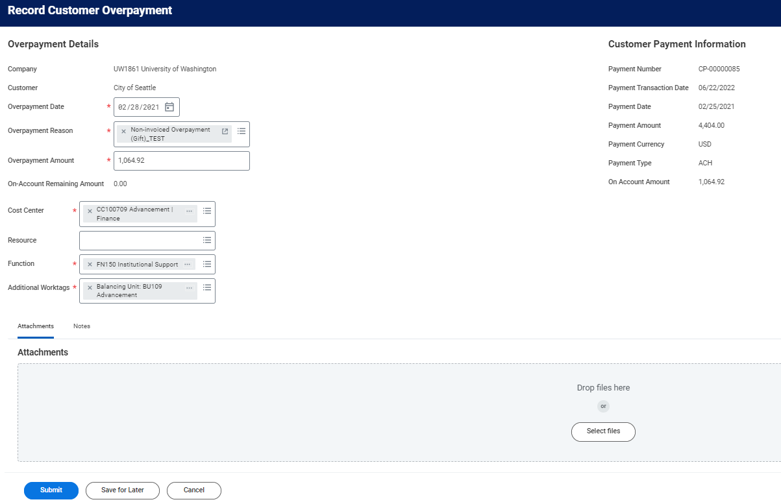
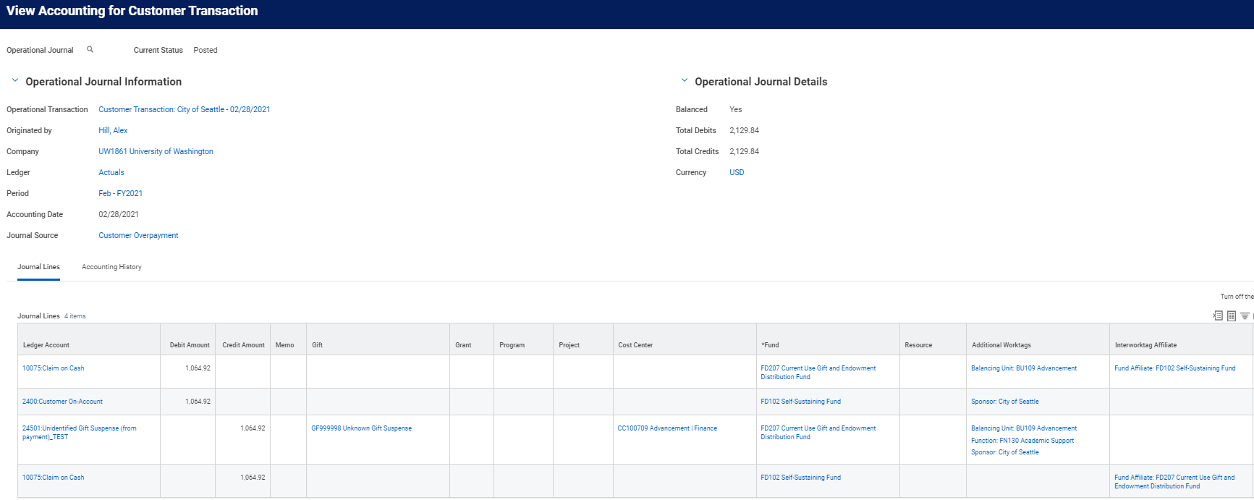
4. Non-invoiced: Customer Overpayment of On-Account balance
Utilize Customer Overpayment APRs by ‘Overpayment Reason’ to produce proper accounting
Notes:
Cash Payment Type applied to invoices – Burke Museum Membership, Dentistry Clinics
Olivia -

Slide 40
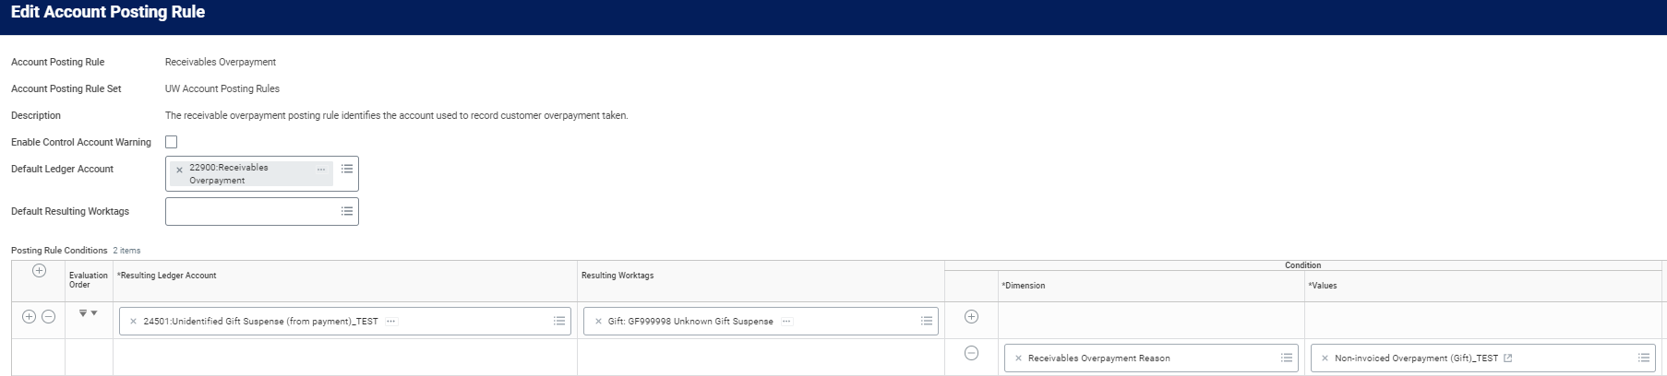
4. Non-invoiced: Customer Overpayment of On-Account balance (APR)
Notes:
Cash Payment Type applied to invoices – Burke Museum Membership, Dentistry Clinics
Olivia -

Slide 41
5. Non-invoiced: Notification of Unit
Cash Application Center can identify non-invoiced payments through the cash application process, and then hand off the appropriate accounting balances to the miscellaneous units involved to continue their daily operations
3rd Party Non-Invoicing Systems
Advancement:
Tandem Gift Application
Unit Notification
Workday Cash Application (Overpayment)
Workday:
Reporting
Integrations
Workday:
Accounting Journal
END
SFS:
SDB Student Payment Application
Account Reconciliation
Notes:
Cash Payment Type applied to invoices – Burke Museum Membership, Dentistry Clinics
Olivia -

Slide 42
Questions and action items
Notes:
Cash Payment Type applied to invoices – Burke Museum Membership, Dentistry Clinics
Olivia -

Slide 43
Cash Application – Proof of concept process
Goal: Automate as much of the cash application process to save time, promote consistency, and limit manual errors
Customer Invoice Created
Customer sends payment to UW
INT1417
Financial Institution Reports Received
Bank Reconciliation Process (Matching, FNR)
Record Customer Payment (via Integration source WD)
Source
INT1418
Create Customer Deposit (via Integration)
Perform payment auto-application to invoices
Manage Exceptions
END
Notes:
Cash Payment Type applied to invoices – Burke Museum Membership, Dentistry Clinics
Olivia -

Slide 44
Questions and action items
Notes:
Cash Payment Type applied to invoices – Burke Museum Membership, Dentistry Clinics
Olivia -

Slide 45
UMBERS
To be handled directly by the GA2C team during future integration calls.
Notes:
Cash Payment Type applied to invoices – Burke Museum Membership, Dentistry Clinics
Olivia -

Slide 46
Cash app environment – Electronic payments
Customer Payment/Deposit Integration from Umbers (exclude from EDI Report Integration)
Notes:
Cash Payment Type applied to invoices – Burke Museum Membership, Dentistry Clinics
Olivia -

Slide 47
Cash application Meeting #4 – Cash Overview, Proof of concept 2, and decisions
08/24/2022
Notes:
[Filename Convention: Customer Confirmation Session E2E Functional Area YYYYMMDD
YYYYDDMM should equal the date of the workshop
E2E Acronym by Business Process Area
AA2R Asset Acquire to Retire
CR2P Customer Requisition to Payment
GA2C Grant Award to Close
H2R Hire to Retire
MCFA Manage Cash and Financial Assets
PMTB Plan and Manage the Business
P&SC Procurement and Supply Chain
PI2C Project Inception to Close
R2R Record to Report ]

Slide 48
Cash Application – Agenda – August 23rd
DRAFT
Topic | Time | Notes
Cash Overview | 15 minutes
Status Update / Recap | 5 minutes
Cash Application Demonstration – Customer Pmt. Source Filtering (POC 2) | 50 minutes | WD Integration Source - Proof of Concept Process Flow/Demo
Decision Recap | 15 minutes
Q&A | 5 minutes
Notes:
Cash Payment Type applied to invoices – Burke Museum Membership, Dentistry Clinics
Olivia -

Slide 49
Status update / recap
Status Update/Recap:
In previous demonstrations, we have seen the following actions:
Cash Application:
How to create customer/sponsor invoices
How to record Customer Payments (Manual & Automated)
How to apply Customer Payments (Manual & Auto-Apply)
3a. How to apply a single payment to multiple customers/invoices
4. How to un-apply Customer Payments
5. How to use Customer/Sponsor Overpayment to move funds to the appropriate ledger
Bank Reconciliation:
How we receive bank statements daily
How we reconcile bank statements (First Notice Rule/Matching)
Question that remains: How do we maximize automation in our cash receipting, cash application, and bank reconciliation processes
To do so, we must combine all of the logic we have learned above…

Slide 50
Proof of Concept 2
Steps:
BAI2 Previous Day Bank Statement File received by SFTP each morning from Bank (Daily), ACH+ File received by SFTP each morning from Bank (Daily)
Submit Bank Statement API run to ‘record bank statement’ in Workday
Auto-Reconciliation is performed each morning to derive reconciliation status for each line. All remaining lines will have a status of either ‘Reconciled’ or ‘Unreconciled’. ‘Unreconciled’ lines in the Find Bank Statement Line report will be used to complete the Put Customer Payment integration and API similar to POC #1 work.
If Wire (191, 195, 208) Type Code, Bank Statement Report and details will be used to populate the Customer Payment API in accordance with mapping below. If ACH (164, 165, 166) Type Code, EDI822* ACH+ File from Bank will be used instead to populate the Customer Payment API in accordance with mapping below.
Submit Customer Deposit API will need to occur next with information from the posted Customer Payment transactions created in Step 4. Customer Deposit will always go to the 6205000 (UW Main Concentration BofA Bank Account). Deposit Memo will include Addenda column text for Wires, or concatenated details from the EDI822* ACH+ File for ACH.
Once Customer Payment and Customer Deposit have been recorded, Auto-Application and Auto-Reconciliation runs will be performed.
Any additional troubleshooting or payment corrections will need to occur manually by the Cash Application Team.

Slide 51
Proof of Concept 2 – Full cash app timeline
Day 30*
Customer/Sponsor Remits Payment
Day 32 (c)
Scheduled Run for Auto-Application kicks off
Day 33
Begin research, update Customer Payments, and continue Cash Application
Day 1
Customer Invoice is Created
Accounting:
DR: AR
CR: Revenue
Day 33…
Manage Exceptions
End of invoicing
Cash Receipt begins
Cash App begins
Cash App
Cash App Hub
Day 32 (b)
INT. 4 begins. Since pmt. Is required, Success log of posted customer payments from INT. 3 is used as source for INT. 4
Accounting:
DR: Unapplied Record Payments
CR: Accounts Receivable
OR
CR: On-Account Payment
Day 32 (a)
INT. 3 begins
If line is “unreconciled”; if Wire use Bank Stmt. File
If ACH use ACH+ File
Accounting:
DR: Cash
CR: Unapplied Recorded Payments
Bank Reconciliation begins
Bank Recon.
BAO Only
Day 31 (c)
Bank Stmt. (BAI2) File is sent to Workday
Day 31 (b)
ACH+ File is sent to SFTP by Bank
Day 31 (a)
Bank Stmt. (BAI2) File is sent to SFTP by Bank
Day 31 (e)
Remaining unreconciled lines of the “Find Bank Statement Line” report will be used to generate Customer Payments via automation
Day 33…
Re-Run Auto-Reconciliation for Bank Statement
Day 31
Customer/Sponsor Payment is received by our financial institution
Day 31 (d)
Auto-Reconciliation for the Main Bank Account Kicks off leveraging FNR and Matching
*Assumption of Net 30

Slide 52
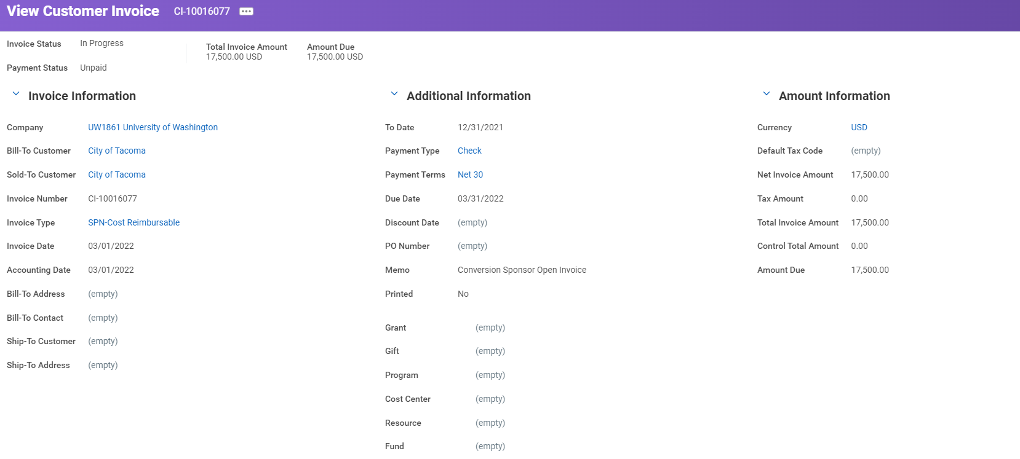
Proof of concept 2 – step by step
Creation of Customer Invoice

Slide 53
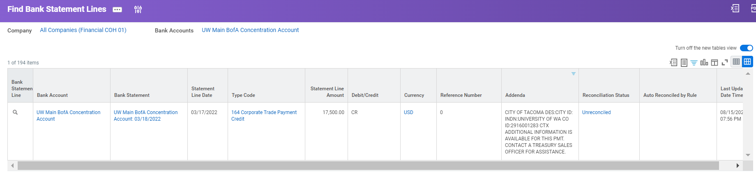
Proof of concept 2 – step by step
Customer Remits Payment/Bank Files Uploaded to SFTP & Workday
PAYMENT LINE | REMITTANCE LINE | Bank Reference # | PAYMENT AMOUNT | C/D | PAYMENTEFFECTIVEDATE | PAYMENTDESCRIPTION | PAYMENTCHECKNUMBER | PAYMENTEM | PAYMENTORIGINATOR | PAYMENTMUTUALLYDEFINED | PAYMENTRECEIVER
9 | 0 | 902575021010434 | 17500 | C | 20220317 |  |  |  | CITY OF TACOMA |  | UNIVERSITY OF WA

Slide 54
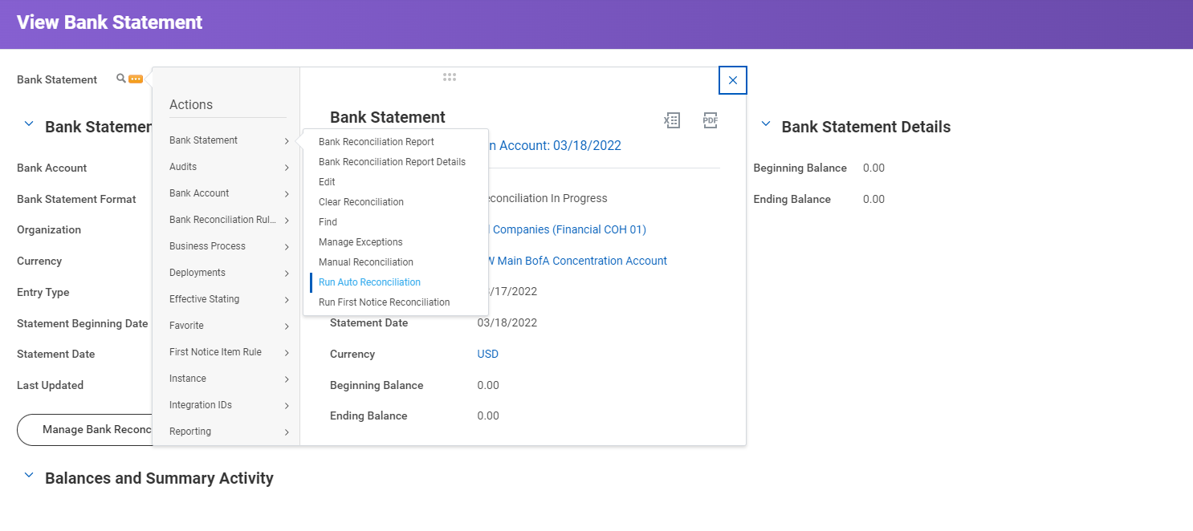
Proof of concept 2 – step by step
Auto-Reconciliation is Run for the Previous Day Bank Stmt.
Transactions that can be reconciled via First Notice Rule or Matching logic will be filtered out of Customer Payment Source file for posting.

Slide 55
Proof of concept 2 – step by step
Auto-Reconciliation is Run for the Previous Day Bank Stmt.
Transactions that can be reconciled via First Notice Rule or Matching logic will be filtered out of Customer Payment Source file for posting.

Slide 56
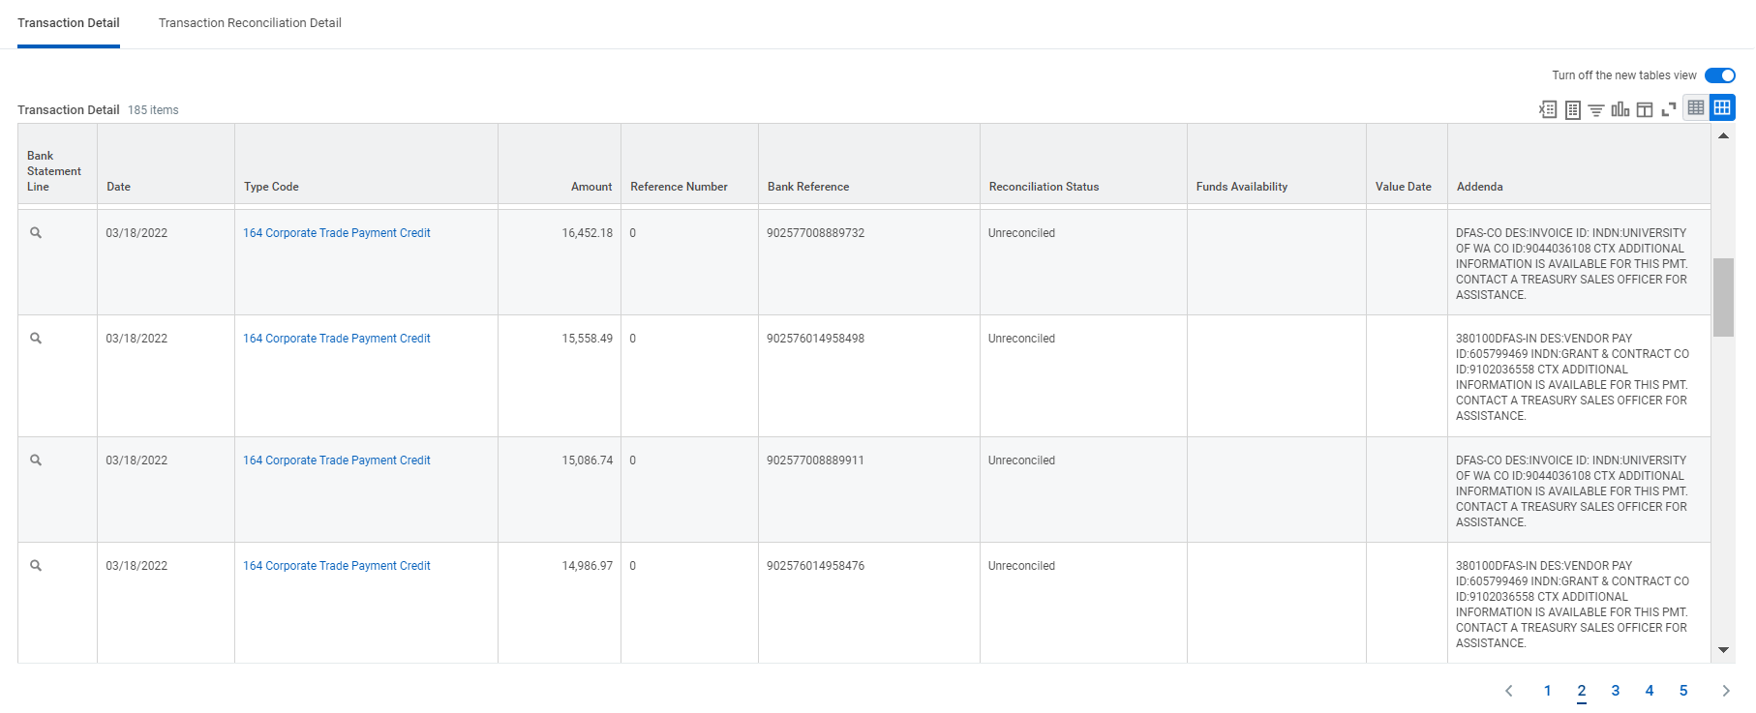
Proof of concept 2 – step by step
Remaining EFT Payments with Reconciliation Status = Unreconciled, will be used to fire INT 3 (Put Customer Payment), to record customer payments

Slide 57
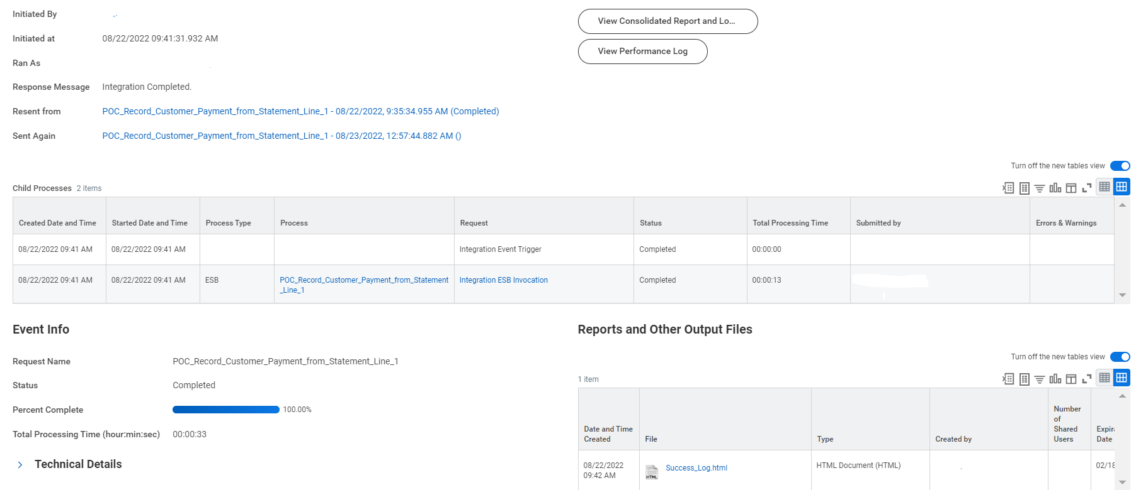
Proof of concept 2 – step by step
After INT3, INT4 will fire to take the successfully posted Customer Payments and create a reconcilable customer deposit.

Slide 58
Proof of concept 2 – step by step
After INT3, INT4 will fire to take the successfully posted Customer Payments and create a reconcilable customer deposit.

Slide 59
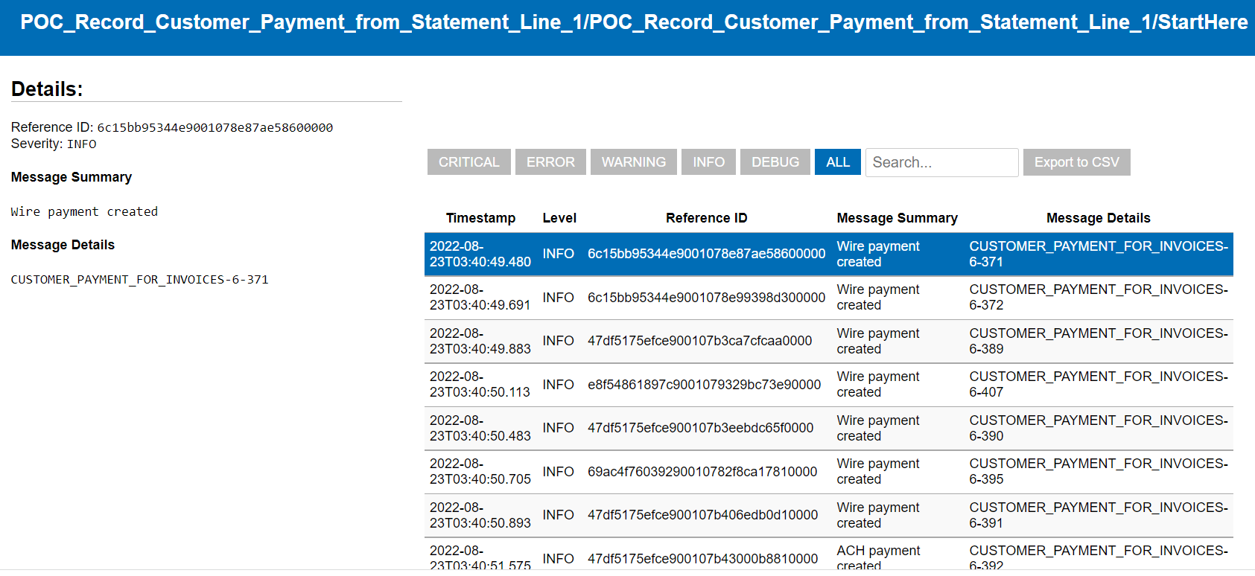
Proof of concept 2 – step by step
After INT3, INT4 will fire to take the successfully posted Customer Payments and create a reconcilable customer deposit.

Slide 60
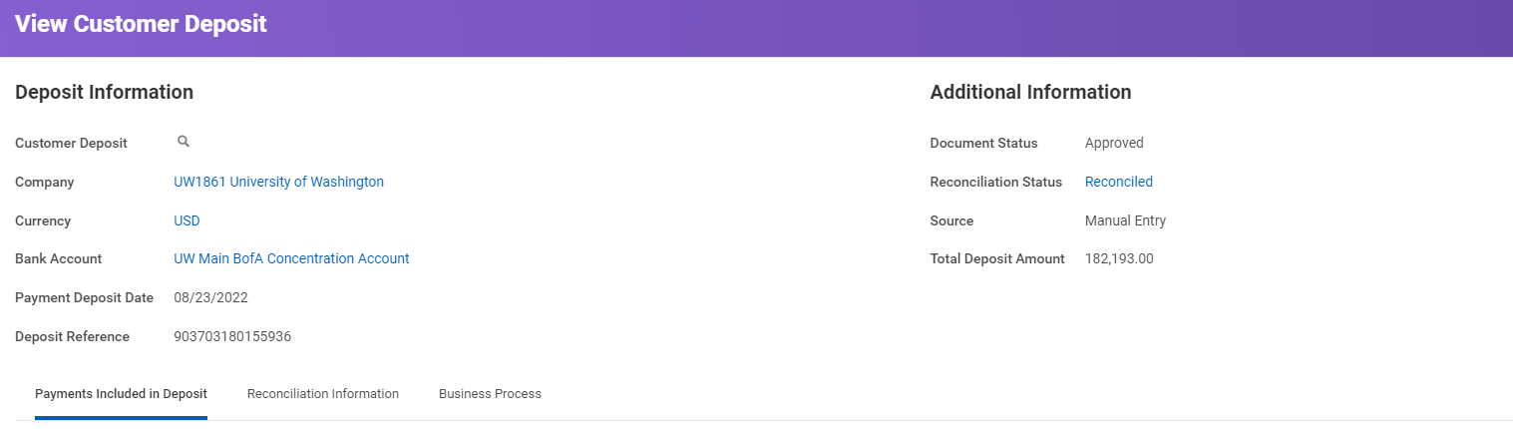
Proof of concept 2 – step by step
After creation of the deposit with the bank reference listed as the Deposit Reference ID, we will now receive additional automated bank reconciliation via the matching ruleset.

Slide 61
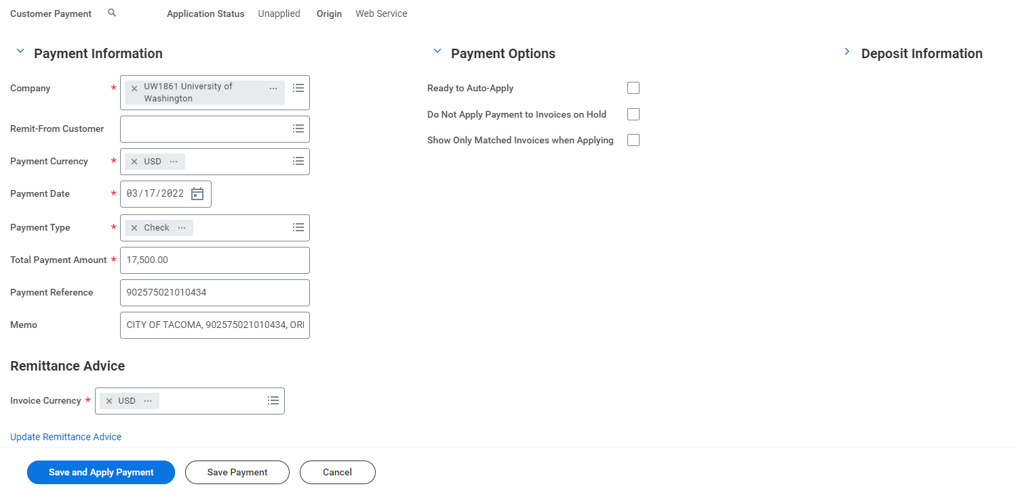
Proof of concept 2 – step by step
Once a payment is created and a deposit is submitted via automated integration, we can now conduct our regular research and cash application process for what remains.

Slide 62
Proof of concept 2 – step by step
Once a payment is created and a deposit is submitted via automated integration, we can now conduct our regular research and cash application process for what remains.

Slide 63
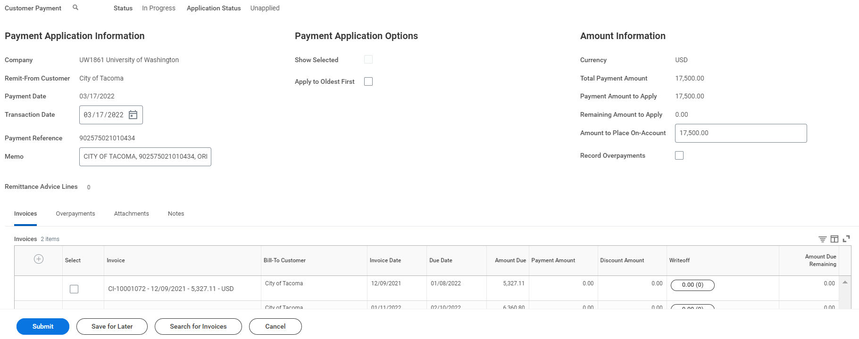
Proof of concept 2 – step by step
Once a payment is created and a deposit is submitted via automated integration, we can now conduct our regular research and cash application process for what remains.

Slide 64
Proof of concept 2 – summary
If the University of Washington is seeking to maximize automation of data entry, cash application, and bank reconciliation it is feasible using only bank data, Workday custom reports, and Workday custom integrations.

Slide 65
Decisions
The remaining body of work is heavily dependent on the optionality of the solutions below…
# | Options | Pros | Cons
1 | Workday Solution: Custom Reporting/Integrations (Proof of Concept 1 & 2) | Highest level of automation Most comparable to today’s processes Limitation of keystrokes and human error in data entry Most timely cash acceptance and consistency of starting point in process System first approach leveraging Workday to provide a workflow of tasks | Maintenance of complex integrations Dependency on bank reconciliation process and submission of daily bank data Requires more specialized/skilled resources
2 | Manual Entry of Customer Payments | Cost efficiency Cleaner split between bank reconciliation and cash application process Less technical maintenance, as all data will reside in Workday as source | Less automation, elements of human error Potential for slower cash application if payments or deposits are prolonged Slower bank reconciliation due to dependency on cash application team
3 | Seek out a Gap Application | TBD | TBD

Slide 66
Jira Reference
Issue Key | Issue Type | Summary | Team Owning | Team Delivering | Assignee | Visibility Level | ??
UWFT-79976 | Risk | If Cash Application design is not complete by 8/31/2022, then FRP system and report remediation will not be completed in time for E2E Cycle 3 Testing | FRP | FNC-Design | Paula Ross | UWFT Executive Director
UWFT-42471 | Decision | Finalize CTMS Cash Application Design Flow | ITES | FNC-Design | Kamesh Naidoo | UWFT Executive Director
UWFT-77298 | Epic | Outstanding Cash Application Questions | FNC-Design | FNC-Design | Kamesh Naidoo | Internal Teams
UWFT-76927 | Action | Cash Application Outstanding Business Process Questions - Integrations | FNC-Design | FNC-Design | Kamesh Naidoo | Internal Teams
UWFT-76928 | Action | Customer Refund via Draw & Other | FNC-Design | FNC-Design | Kamesh Naidoo | Internal Teams
UWFT-77227 | Action | Suspense Accounts in Future State | FNC-Design | FNC-Design | Kamesh Naidoo | Internal Teams
UWFT-76929 | Action | Beginning Balances - Validating Cash at the Award & Award Line Level | FNC-Design | FNC-Design | Kamesh Naidoo | Internal Teams

Slide 67
Q&A

Slide 68
EDGE Cases
Edge case examples:
No Remit-From Customer available at time of recorded Customer Payment
Single Payment belonging to multiple customer/sponsor related invoices
Gift Money received in the Main Concentration Account
Patient Money received in the Main Concentration Account
Student Payments received in the Main Concentration Account
Customer vs. Sponsor Funds recorded in the Main Concentration Account
Identified Refund of payments received in the Main Concentration Account
Centrally invoiced payments remitted to another UW Bank Account
Unreconcilable payments (temporary)
Un-applyable payments (temporary)

Slide 69
Contingency Plan
Due to our set Go-Live date and the timing in the project, a contingency plan should be considered by the University of Washington

Slide 70
Cash Application – Meeting Agenda – June 14th
DRAFT
Topic | Time | Notes
Cash Application Overview | 30 minutes | Refresher of Cash App Concepts
Cash Application Demonstration – Bank File Integration (POC) | 30 minutes | WD Integration Proof of Concept Process Flow/Demo
Exception Management | 15 minutes | Troubleshooting
Action Items/Next Steps | 5 minutes
Q&A | 5 minutes
Notes:
Cash Payment Type applied to invoices – Burke Museum Membership, Dentistry Clinics
Olivia -

Slide 71
Cash app environment – Electronic payments
Customer Payment/Deposit Integration from Umbers (exclude from EDI Report Integration)
Customer Overpayment
Customer Payment/Deposit Integration from EDI 822 File from Bank of America
Manual intervention/application
Customer Payment/Deposit Integration from EDI 822 File from Bank of America
Notes:
Cash Payment Type applied to invoices – Burke Museum Membership, Dentistry Clinics
Olivia -

Slide 72
Cash Application – Overview
DRAFT
Step | Debit | Credit
Record Payment | N/A | N/A
Apply Payment | Undeposited Receipts | Receivables
Create Deposit | Cash | Undeposited Receipts
Record Payment | N/A | N/A
Create Deposit | Cash | Unapplied Recorded Payments
Apply Payment | Unapplied Recorded Payments | Receivables
Record/Apply Payment | Undeposited Receipts | Receivables
Create Deposit | Cash | Undeposited Receipts
Notes:
Cash Payment Type applied to invoices – Burke Museum Membership, Dentistry Clinics
Olivia -

Slide 73
Cash Application: Non-Invoiced Proof of concept process
Goal: Automate as much of the cash application process to save time, promote consistency, and limit manual errors. Bucket cash requiring 3rd party involvement without creating a need to cancel payments.
Customer Invoice Created
Customer sends payment to UW
Financial Institution Reports Received
Record Customer Payment (via Integration)
INT001
Source
INT002
Create Customer Deposit (via Integration)
Apply to invoices
Apply to On-Account
Record Customer Overpayment
3rd Party System (i.e. Tandem, SDB)
END
Accounting Journal Reclass
INT003
Notes:
Cash Payment Type applied to invoices – Burke Museum Membership, Dentistry Clinics
Olivia -

Slide 74
Cash Application - Overview
What goes into the Cash Application process:
Cash application can be broken down into 3 simple parts:
Recording of the Customer/Sponsor Payment
Provides you a source of payment that can be applied to invoices (No accounting entry produced)
Recorded at the customer account level
Depositing of the Customer/Sponsor Payment
Must be recorded after a customer payment (with reference)
Debits Cash and requires a bank account worktag
Application of the Customer/Sponsor Payment to an open invoice or customer account
Application of a payment can be performed manually or through auto-application
Application is performed at an invoice(s) level or is applied on to the customer account
Notes:
Cash Payment Type applied to invoices – Burke Museum Membership, Dentistry Clinics
Olivia -

Slide 75
Cash Application - OVerview
How does the University receive customer/sponsor payments:
Primarily in 2 ways – Via Check or EFT (ACH/Wire)
When these payments are received, they are captured within our university owned bank accounts and appear on our daily bank statements/bank reporting.
Notes:
Cash Payment Type applied to invoices – Burke Museum Membership, Dentistry Clinics
Olivia -

Slide 76
Cash Application Demonstration - Manual
Customer Invoice is created in Workday and sent to our Customer(s)
Once payment is recorded; Customer Deposit is created in Workday
Payment is received from our customer and recorded in Workday
Application of the payment to an open invoice or customer account
Notes:
Cash Payment Type applied to invoices – Burke Museum Membership, Dentistry Clinics
Olivia -

Slide 77
Unique use cases
What if the payment is half Customer invoice payment and half sponsor related invoice payment?
Remit-From Customer will be either the customer or sponsor instance of the payee. The Additional remittance detail below will call out the appropriate invoice and split the application between the two.
Difficulty: Low; Frequency: Low
What if the payment is split between two separate companies or intercompany in nature?
Workday intentionally allows acceptance of payments on behalf of another company. Application occurs as normal and intercompany accounting will be produced inherently in Workday.
Difficulty: Low; Frequency: Medium
Notes:
Cash Payment Type applied to invoices – Burke Museum Membership, Dentistry Clinics
Olivia -

Slide 78
Unique use cases
C. What if the payment is half Customer/Sponsor invoice payment and a Gift related non-invoice payment?
Recommendation: Customer Payment still recorded through automation, Overpayment functionality leveraged to post proper accounting prior to being picked up by Tandem/Advancement.
Advancement Team notified to begin thinking through this accounting.
Difficulty: Medium; Frequency: Low
D. What if the payment is half Customer/Sponsor invoice payment and a Student related non-invoiced in Workday payment?
Recommendation: Customer Payment still recorded through automation, Overpayment functionality leveraged to post proper accounting prior to being picked up by SFS.
SFS notified and is thinking through appropriate accounting and process with SDB.
Difficulty: Medium; Frequency: Low
Notes:
Cash Payment Type applied to invoices – Burke Museum Membership, Dentistry Clinics
Olivia -

